Slide 1
Microphase Segregation of Polyelectrolyte Brushes
Takashi Yokokura
Advisor: Prof. Rui Wang
UC Berkeley, Chemical and Biomolecular Engineering
Charged and Ion-Containing Polymers I
3/6/2023, 8:00 am - 11:00 am

Slide 2
Introduction
Polymer brushes are /interesting/ for both applications and biological understanding
Systematic study explores possible phase space for discovery of new conformational targets and possible transition mechanisms

Slide 3
Motivation
Theory helps to understand mechanisms and structures that are not experimentally available or not predicted
Few theories can handle electrostatics, while others make compromises on polymer physics

Slide 4
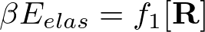

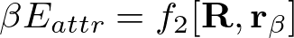


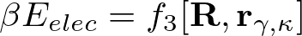



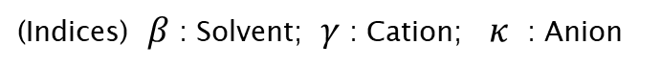
System Species and Interactions
What is the system made up of?
s
+
-
Interactions:
Elasticity (monomer-monomer)
Solubility (solvent-monomer)
Electrostatics (ion-monomer)
Polymer curve
+
-
s
+
s
s
s
-
+
+
+
+
+
+
+
-
+
s
Discrete particle locations
+
s
+
-
s
+
-
s
s
+
+
s
(Indices) $β$ : Solvent; $γ$ : Cation; $κ$ : Anion

Slide 5


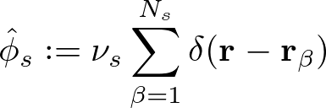






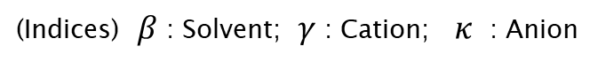
Partition Function Formulation
(Subscripts) $s$ : Solvent; $p$ : Polymer; $e$ : Charged
(Indices) $β$ : Solvent; $γ$ : Cation; $κ$ : Anion
Elastic entropy following Gaussian statistics
Particle Operators
Flory-Huggins short-range interactions
Electrostatic correlations
Local incompressibility
Coulomb Operator
Semicanonical Ensemble

Slide 6














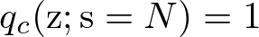
Free Energy and SCF Equations
Free Energy (ensemble average across surface)
Functional Minimization
Polymer Density:
Polymer-controlling Field:
Solvent Density:
Solvent-controlling Field:
Incompressibility:
Monomer Probability:
Electrostatic Potential:

Slide 7
Outline
Systematic Study (VdW Attraction vs. Electrostatic Repulsion)
s
s
s
+
s
+
s
+
+
+
+
+
s
s
+
+
s
Hydrophobicity
(VdW attraction)
s
s
+
s
s
Attractive
Repulsive
Polymer charge fraction
(Electrostatic repulsion)

Slide 8
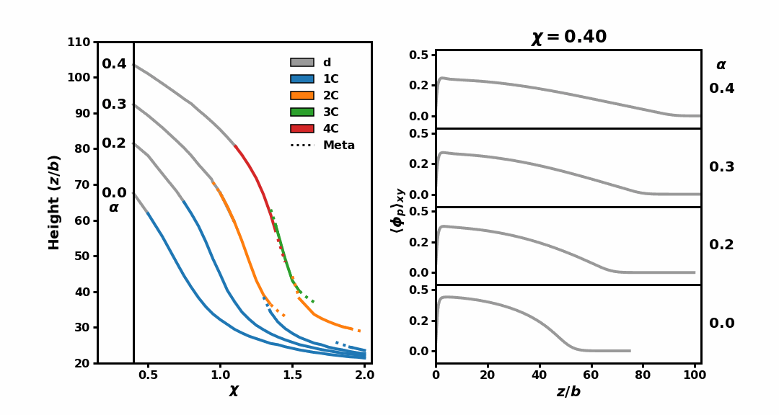
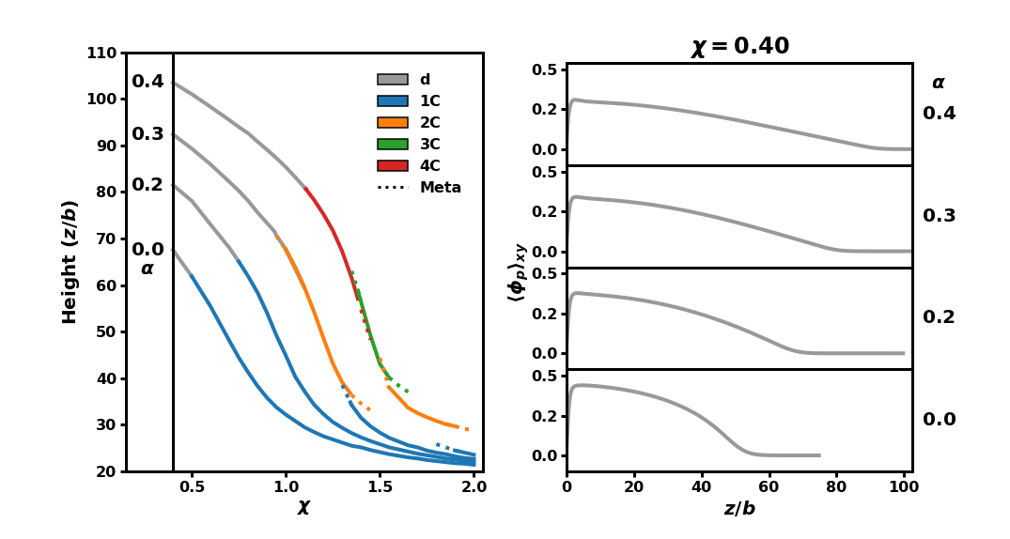


Number of layers tunable with polymer charge fraction
System:
C = “condensed” layer(s)
(nm)
Repulsion
Attraction
Key observations:
Polymer distribution
Polymer smeared charge
Flory-Huggins parameter
High repulsion enriches conformational space
At intermediate repulsion, multiple condensed layers coexist with a dilute layer
High relative attraction eventually causes loss of sensitivity to repulsion

Slide 9



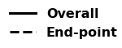

Chain organization within brush is deducible by SCFT
Two candidates with identical averaged density profiles
2 condensed
“Locked-in-layer” minimizes elastic penalty using mushroom conformations
Energetic cost of segregation scales with number of monomers within the “stem” traversing layers
4 condensed + 1 dilute
“Locked-in-layer”
“Pearl-necklace-like”
(Endpoint densities x 30)

Slide 10
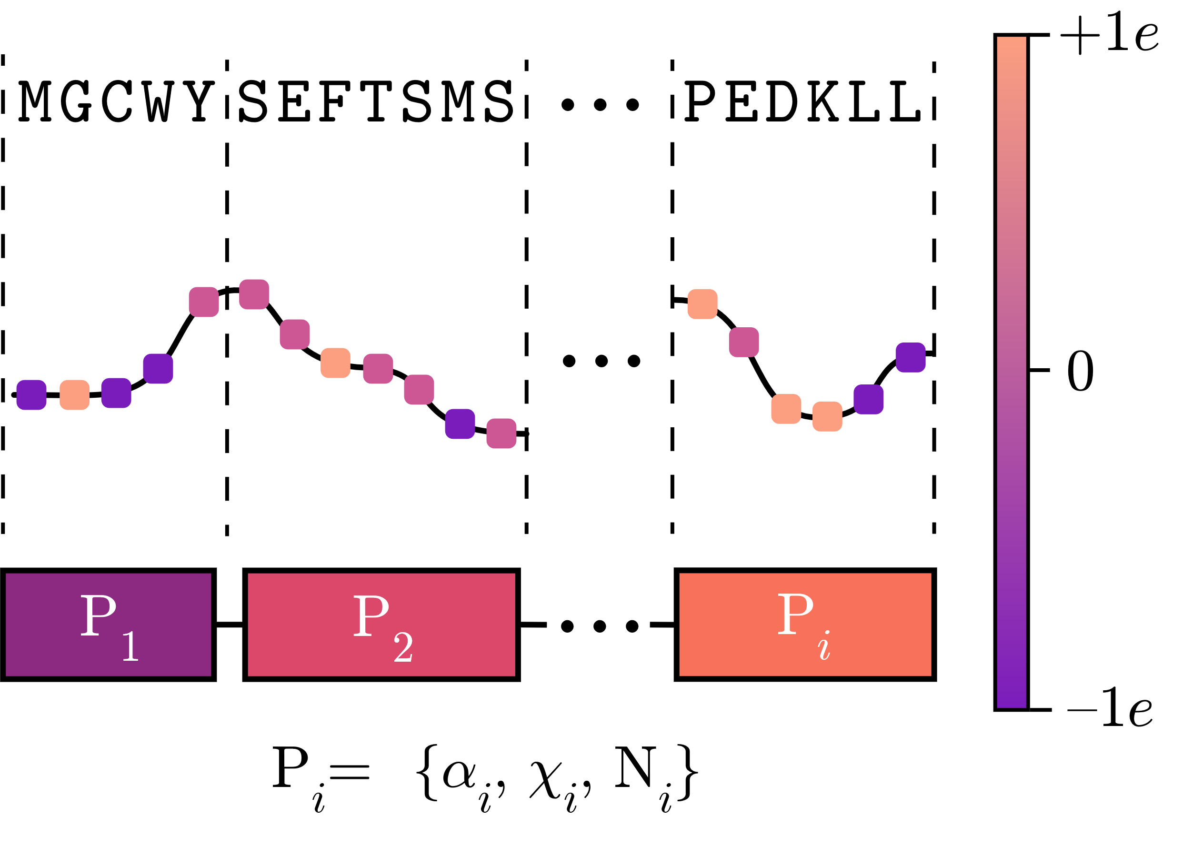
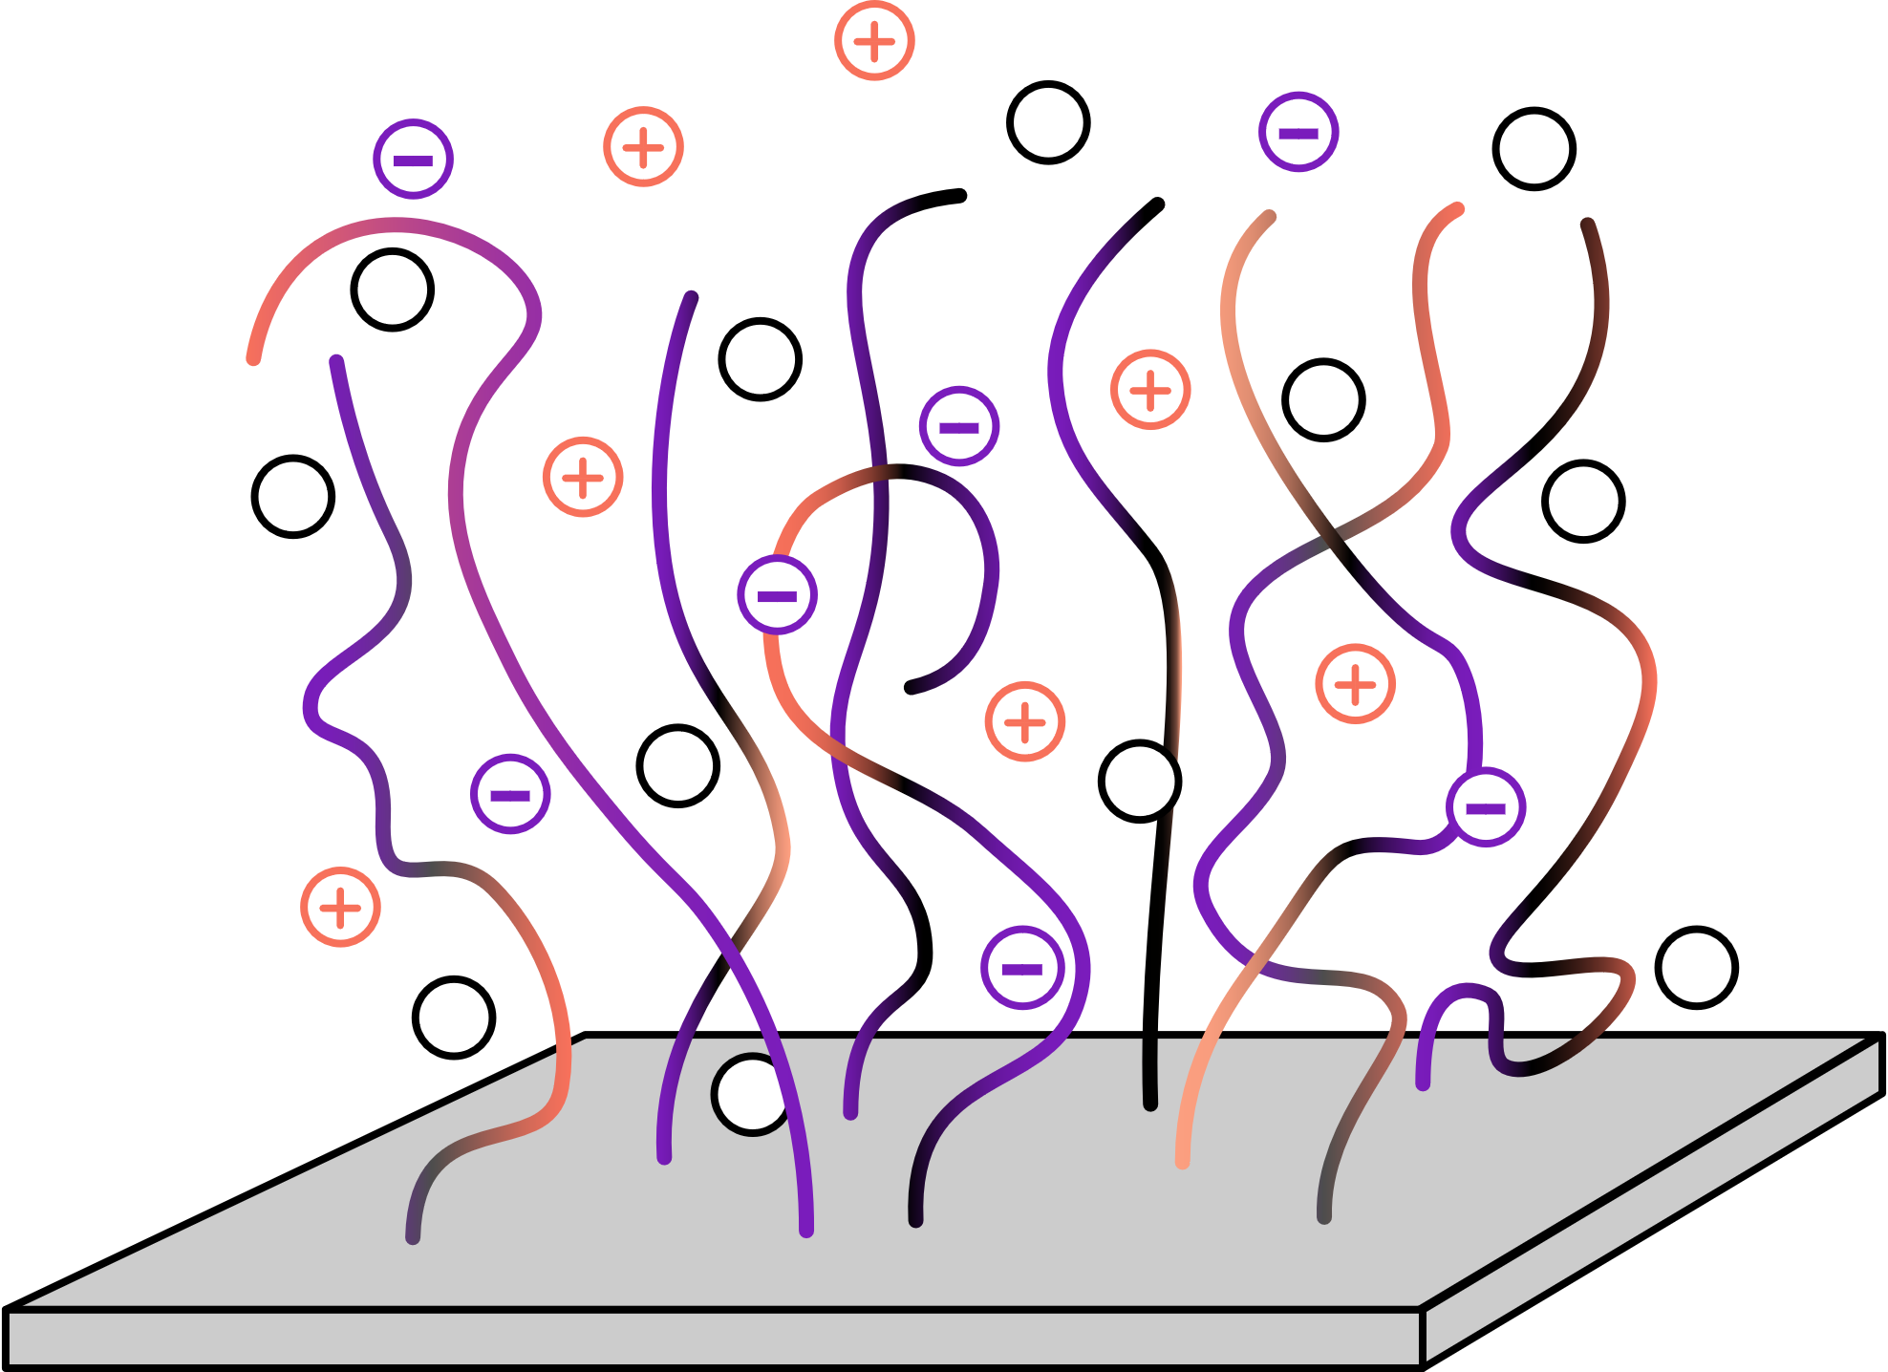
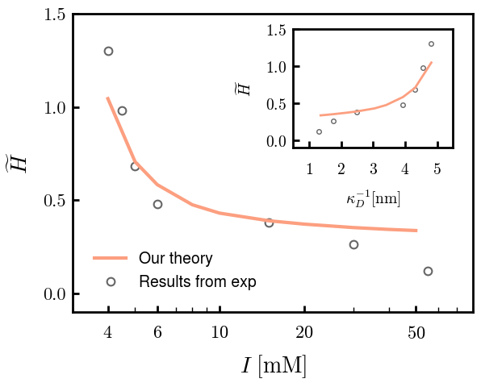
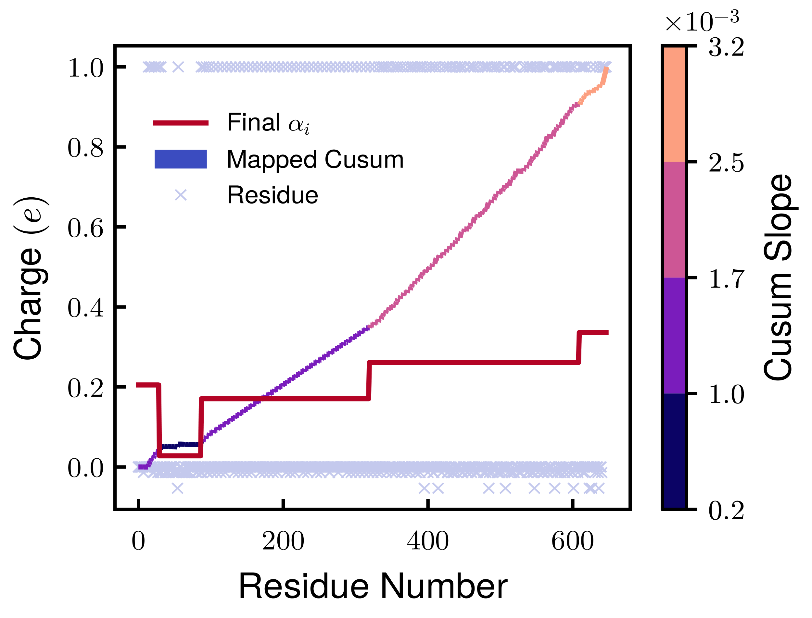
IDP-derived Brush
Neurofilament Heavy
Coarse-graining
Experimental Comparison

Slide 11
Acknowledgements

